Slide 1
Interprocess Communication (IPC)
Tasniya Ahmed
Lecturer
IIT
NSTU

Slide 2
Interprocess Communication (IPC)
Interprocess Communication(IPC) is a process of exchanging the data between two or more independent process in a distributed environment is called as Interprocess communication.
Includes invoking remote elements
Methods of IPC
Request reply protocol(RRP): Requestor requests with a message and gets a reply
Remote Procedure Call(RPC): Extension of normal function calling where the called and calling procedure are not in same address space.
Remote Method Invocation(RMI): Use of OOP concept in distributed envt.
Isha padhy, Department of CSE
<number>

Slide 3
Applications
Remote invocation, indirect communication
Middleware
Underlying interprocess communication primitives:
layers
Sockets, message passing, multicast support, overlay networks
UDP and TCP
Isha padhy, Department of CSE
<number>

Slide 4
Remote Invocation
RMI stands for Remote Method Invocation. It is a mechanism that allows an object residing in one system (JVM) to access/invoke an object running on another JVM.
RMI is used to build distributed applications; it provides remote communication between Java programs.

Slide 5
Architecture of an RMI Application
In an RMI application, we write two programs, a server program (resides on the server) and a client program (resides on the client).
Inside the server program, a remote object is created and reference of that object is made available for the client (using the registry).
The client program requests the remote objects on the server and tries to invoke its methods.
The following diagram shows the architecture of an RMI application.

Slide 6
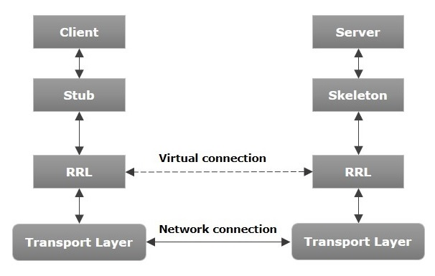

Slide 7
Let us now discuss the components of this architecture.
Transport Layer − This layer connects the client and the server. It manages the existing connection and also sets up new connections.
Stub − A stub is a representation (proxy) of the remote object at client. It resides in the client system; it acts as a gateway for the client program.
Skeleton − This is the object which resides on the server side. stub communicates with this skeleton to pass request to the remote object.
RRL(Remote Reference Layer) − It is the layer which manages the references made by the client to the remote object.

Slide 8
Marshalling and Unmarshalling
Whenever a client invokes a method that accepts parameters on a remote object, the parameters are bundled into a message before being sent over the network. These parameters may be of primitive type or objects. In case of primitive type, the parameters are put together and a header is attached to it. In case the parameters are objects, then they are serialized. This process is known as marshalling.
At the server side, the packed parameters are unbundled and then the required method is invoked. This process is known as unmarshalling.

Slide 9
RRP
Why RRP?
Acknowledgements are unnecessary if request and reply are done immediately.
Establishing connection requires extra message other than send, receive
Flow control is not required in remote invocations if small arg and results are passed.
Isha padhy, Department of CSE
<number>

Slide 10
Communication primitives
public byte[] doOperation (RemoteRef s, int operationId, byte[] arguments) sends a request message to the remote server and returns the reply.
Used by the clients to invoke remote operations.
The arguments specify the remote server, the operation to be invoked and the arguments of that operation.
Result is a byte of array containing result.
S is instance of class RemoteRef which provides a method for getting the internet address and port of server. The caller of this operation is blocked until a reply is received.
public byte[] getRequest ();
Used by server to acquire a client request via the server port.
public void sendReply (byte[] reply, InetAddress clientHost, int clientPort);
Server invokes the required operation and sends the reply message to the client at its Internet address and port.

Slide 11
Request-reply message structure
int (0=Request, 1= Reply)
int// message identifier
RemoteRef
int or Operation// identifier for the operation to be invoked
array of bytes
requestID- taken from increasing sequence of integers Identifier for sender process= port + IP
messageType
requestId
remoteReference
operationId
arguments

Slide 12
Failure and timeouts
•
-
-
-
•
•
Types of failure:
Omission failure
No gaurantee of message delivery Process failure
After a timeout , return from doOperation method to stop the method.
Discarding duplicate request message- To avoid re-executing the same procedure repeatedly because of getting the same request repeatedly, the server rejects the requests with same identifier number.
Lost reply message- Once the execution is over ,its result must be stored in server side so that it can retransmit the result whenever required.
Idempotent operation: operation that can be performed repeatedly with the same effect as if it had been performed exactly once.
If any operation is idempotent then any number times the request can be done but otherwise the step should be stopped to prevent wrong values and also overhead is more.
•
•
•
Isha padhy, Department of CSE
<number>

Slide 13
Styles of exchange protocols
Request (R) protocol- No requirement of reply or acknowledgment . Soon after request, the client carries out with the other application. Implemented over datagram protocol.
Request- reply protocol(RR) - No ACK required because reply acts as ACK. Implemented on UDP.
Request- reply- ACK protocol(RRA)- The ACK message contains requestId from the reply message being acknowledged. The arrival of requestId in ACK is interpreted as ACK receipt of all reply messages with lower requestId.
7

Slide 14
Use of TCP streams to implement RRP
•
Use of limited length of datagrams is not always acceptable in RMI/ RPC because the argument and result can be of any size.
TCP guarantees message delivery, no need of retransmissions.
No need to create connection if subsequent request- reply goes on between same client and server.
Example is HTTP, FTP, SMTP,telnet
It specifies messages involved in methods, arguments, results, rules of marshalling.
It supports a fixed set of methods applicable to all server’s resources.
Allows invoking methods on web resources, content negotiation, password style authentication.
•
•
•
-
-
-

Slide 15
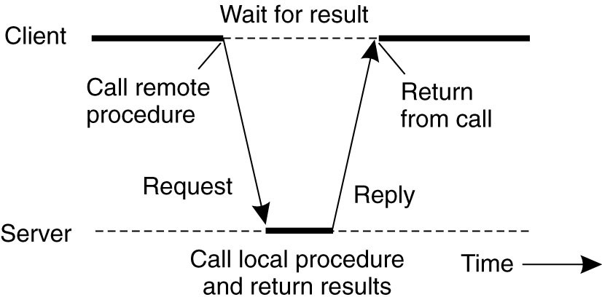
RPC (Remote procedure Call)
•
Based on extending the idea of conventional local procedure calling, where called and calling procedure are in different address space.
Isha padhy, Department of CSE
<number>

Slide 16
Difference between local and remote procedure call
•
Local procedure call is done either by call by value or call by address/ reference.
In remote procedure call , this is not possible because the address space of procedure calling and one that is called are different.
•
So RPC can be done by *stubs- proxies, Flattening-marshalling.
*Stubs- A stub is a piece of code that is used to convert parameters during a RPC. Since RPC allows a client computer to call remote procedures on server as local procedures, the parameters used in function call have to be converted. Stub libraries are installed on the client and server.
<number>

Slide 17
Goals of RPC
The message passing nature of network communication is hidden from user. The user does not open a connection and close connection.
Often omits many protocol layers to improve performance.
Isha padhy, Department of CSE
<number>

Slide 18
Design issues for RPC
1. Programming with Interfaces – Communication within modules(program divided into modules) can interact by means of procedure call or direct access to variables in another module. So every module has an interface which provides specific methods and variables that can be made available.
- Each server provides a set of procedures for clients through an interface called as Service Interface.
Isha padhy, Department of CSE
<number>

Slide 19
Adv. Of Interface
Programmers are concerned only with the idea offered by service interface and not implementation.
Programmers need not know the programming language or underlying platform used to implement the service.
The variables of one module cannot be directly accessed by the client module running in another process, so it is done by some getter
and setter proced^{Is}u^{ha} r^{pa}e^{dh}s^{y, De}i^{p}n^{artm}t^{en}h^{t o}e^{f CSE}interface.
13

Slide 20
2. RPC call semantics-
There are choices for delivery guarantee:-
a. Retry- request message- Controls whether to retransmit request message until a reply is received/ server is assumed to have failed.
b.Duplicate filtering- Whether to filter out the duplicate requests at server.
c. Retransmission of result – whether to keep history of result to avoid re-executing the operations if retransmission of result is required.
Isha padhy, Department of CSE
<number>

Slide 21
Call semantics
1. May- be- semantics: RPC may be executed once or not at all
-
Applicable when no fault- tolerance measures are applied.
At- least once: The invoker either receives a result or an exception informing no result was received. That means the procedure executed at-least once.
At- most once: Client receives either a result/ an exception.
-
-
Can be achieved by using all fault- tolerance measures.
Prevents arbitrary failures ensuring for each RPC the procedure executed once.
Isha padhy, Department of CSE
<number>

Slide 22
Steps of RPC
The client procedure calls the client stub in the normal way.
The client stub builds a message and calls the local operating system.
The client’s OS sends the message to the remote OS.
The remote OS gives the message to the server stub.
The server stub unpacks the parameters and calls the server.
The server does the work and returns the result to the stub.
The server stub packs it in a message and calls its local OS.
The server’s OS sends the message to the client’s OS.
The client’s OS gives the message to the client stub. 10.The stub unpacks the result and returns to the client.
Isha padhy, Department of CSE
<number>

Slide 23
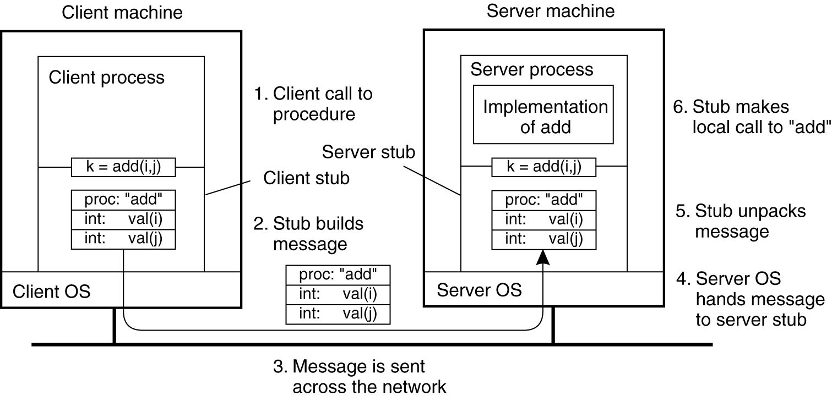
The steps involved in a doing a remote computation through RPC.
Isha padhy, Department of CSE
<number>

